Slide 1
ME16A: INTRODUCTION TO STRENGTH OF MATERIALS
COURSE INTRODUCTION

Slide 2
Details of Lecturer
Course Lecturer: Dr. E.I. Ekwue
Room Number: 216 Main Block, Faculty of Engineering
Email: ekwue@eng.uwi.tt ,
Tel. No. : 662 2002 Extension 3171
Office Hours: 9 a.m. to 12 Noon. (Tue, Wed and Friday)

Slide 3
COURSE GOALS
This course has two specific goals:
(i) To introduce students to concepts of stresses and strain; shearing force and bending; as well as torsion and deflection of different structural elements.
(ii) To develop theoretical and analytical skills relevant to the areas mentioned in (i) above.

Slide 4
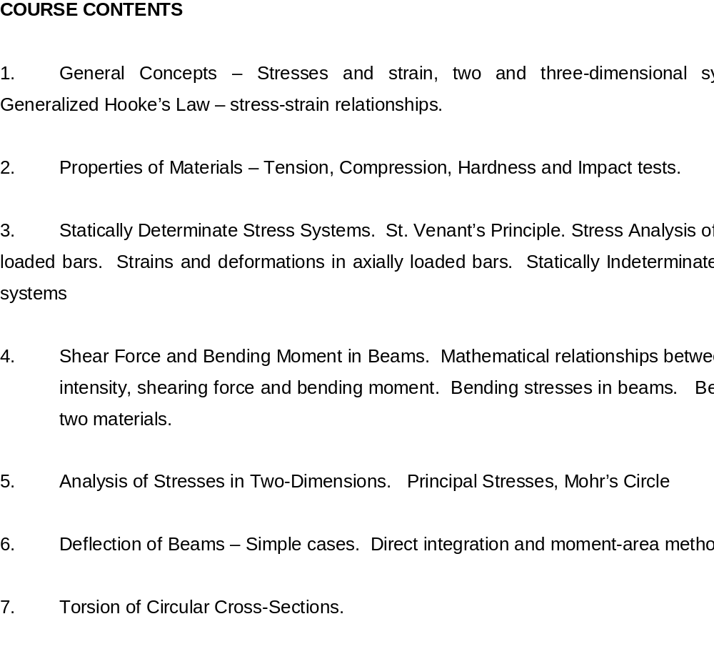
COURSE OUTLINE

Slide 5
Course Objectives
Upon successful completion of this course, students should be able to:
(i) Understand and solve simple problems involving stresses and strain in two and three dimensions.
(ii) Understand the difference between statically determinate and indeterminate problems.
(iii) Understand and carry out simple experiments illustrating properties of materials in tension, compression as well as hardness and impact tests.

Slide 6
COURSE OBJECTIVES CONTD.
(iv) Analyze stresses in two dimensions and understand the concepts of principal stresses and the use of Mohr circles to solve two-dimensional stress problems.
(v) Draw shear force and bending moment diagrams of simple beams and understand the relationships between loading intensity, shearing force and bending moment.
(vi) Compute the bending stresses in beams with one or two materials.

Slide 7
OBJECTIVES CONCLUDED
(vii) Calculate the deflection of beams using the direct integration and moment-area method.
(viii) Apply sound analytical techniques and logical procedures in the solution of engineering problems.

Slide 8
Teaching Strategies
The course will be taught via Lectures. Lectures will also involve the solution of tutorial questions. Tutorial questions are designed to complement and enhance both the lectures and the students appreciation of the subject.
Course work assignments will be reviewed with the students.

Slide 9
Lecture Times
Wednesday: 2.00 to 2.50 p.m.
Thursday: 11.10 a.m. to 12.00 noon
Friday: 1.00 to 1.50 p.m.
Lab Sessions: Two Labs per student on Mondays (Details to be Announced Later)
Attendance at the Lectures and Labs is Compulsory.

Slide 10
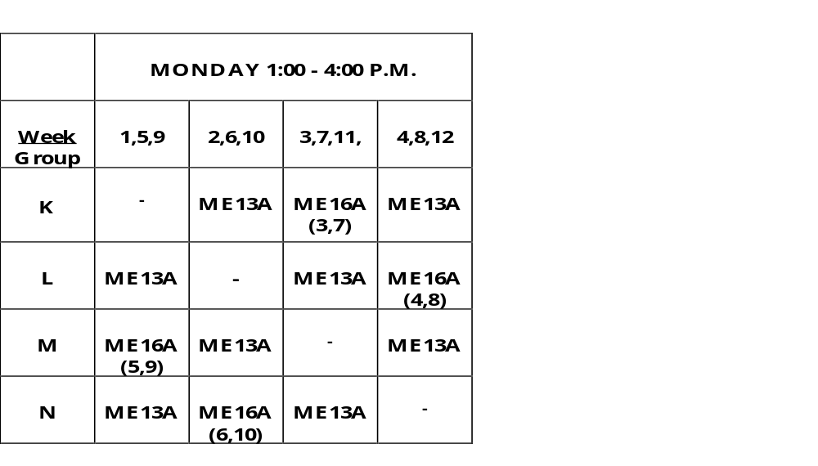
Time-Table For Labs

Slide 11
More Course Details
BOOK – Hearn, E.J. (1997), Mechanics of Materials 1, Third Edition, Butterworth, Heinemann
COURSE WORK
1. One Mid-Semester Test (20%);
2. Practical report (15%) and
3. End of Semester 1 Examination (65%).

Slide 12
ME16A: CHAPTER ONE
STRESS AND STRAIN RELATIONS

Slide 13
1.1 DIRECT OR NORMAL STRESS
When a force is transmitted through a body, the body tends to change its shape or deform. The body is said to be strained.
Direct Stress = Applied Force (F)
Cross Sectional Area (A)
Units: Usually N/m² (Pa), N/mm², MN/m², GN/m² or N/cm²
Note: 1 N/mm² = 1 MN/m² = 1 MPa

Slide 14

Direct Stress Contd.
Direct stress may be tensile, _{t} or compressive, _{c} and result from forces acting perpendicular to the plane of the cross-section
Tension
Compression

Slide 15
1.2 Direct or Normal Strain
When loads are applied to a body, some deformation will occur resulting to a change in dimension.
Consider a bar, subjected to axial tensile loading force, F. If the bar extension is dl and its original length (before loading) is L, then tensile strain is:

Slide 16

Direct or Normal Strain Contd.
F
F
L
dl
Direct Strain ( ) = Change in Length
Original Length
i.e. = dl/L

Slide 17
Direct or Normal Strain Contd.
As strain is a ratio of lengths, it is dimensionless.
Similarly, for compression by amount, dl: Compressive strain = - dl/L
Note: Strain is positive for an increase in dimension and negative for a reduction in dimension.

Slide 18
1.3 Shear Stress and Shear Strain
Shear stresses are produced by equal and opposite parallel forces not in line.
The forces tend to make one part of the material slide over the other part.
Shear stress is tangential to the area over which it acts.

Slide 19


Shear Stress and Shear Strain Contd.
x
C’
C
D
D’
F
P
Q
L
S
R
A
B
Shear strain is the distortion produced by shear stress on an element or rectangular block as above. The shear strain, (gamma) is given as:
= x/L = tan

Slide 20

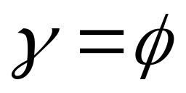
Shear Stress and Shear Strain Concluded
For small ,
Shear strain then becomes the change in the right angle.
It is dimensionless and is measured in radians.

Slide 21


1.3 Complementary Shear Stress
P
Q
a
S
R
Consider a small element, PQRS of the material in the last diagram. Let the shear stress created on faces PQ and RS be

Slide 22
Complimentary Shear Stress Contd.
The element is therefore subjected to a couple and for equilibrium, a balancing couple must be brought into action.
This will only arise from the shear stress on faces QR and PS.
Let the shear stresses on these faces be .

Slide 23
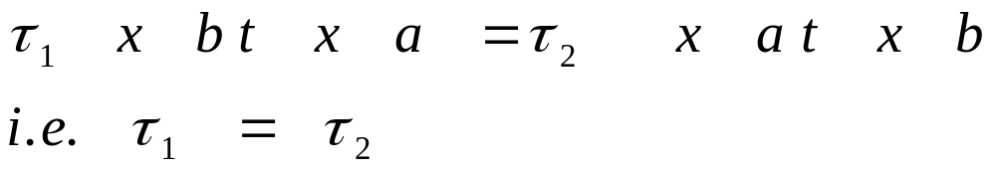
Complimentary Shear Stress Contd.
Let t be the thickness of the material at right angles to the paper and lengths of sides of element be a and b as shown.
For equilibrium, clockwise couple = anticlockwise couple
i.e. Force on PQ (or RS) x a = Force on QR (or PS) x b

Slide 24
Complimentary Shear Stress Concluded
Thus: Whenever a shear stress occurs on a plane within a material, it is automatically accompanied by an equal shear stress on the perpendicular plane.
The direction of the complementary shear stress is such that their couple opposes that of the original shear stresses.

Slide 25
1.4 Volumetric Strain
Hydrostatic stress refers to tensile or compressive stress in all dimensions within or external to a body.
Hydrostatic stress results in change in volume of the material.
Consider a cube with sides x, y, z. Let dx, dy, and dz represent increase in length in all directions.
i.e. new volume = (x + dx) (y + dy) (z + dz)

Slide 26


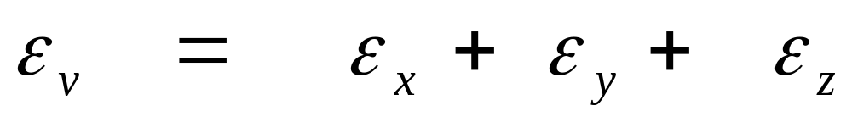
Volumetric Strain Contd.
Neglecting products of small quantities:
New volume = x y z + z y dx + x z dy + x y dz
Original volume = x y z
= z y dx + x z dy + x y dz
Volumetric strain, = z y dx + x z dy + x y dz
x y z
= dx/x + dy/y + dz/z

Slide 27
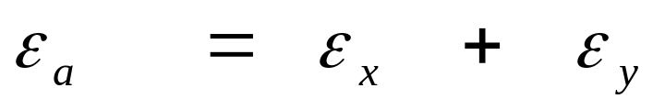
Strains Contd.
Note: By similar reasoning, on area x y
Also: (i) The strain on the diameter of a circle is equal to the strain on the circumference.
(ii) The strain on the area of a circle, is equal to twice the strain on its diameter.
(iii) Strain on volume of a sphere, is equal to three times the strain on its diameter.

Slide 28
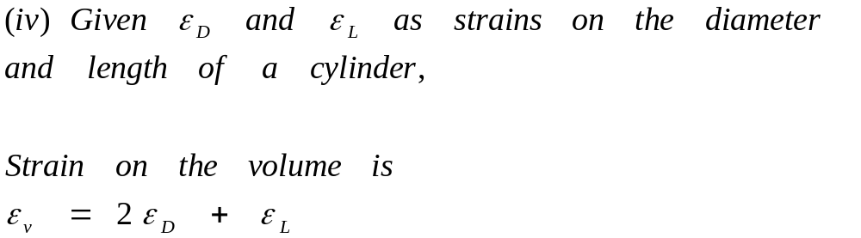
Strains Contd.
These can be proved using the theorem
of small errors

Slide 29


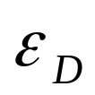
Examples
(i) Diameter, D = 2 x radius, r i.e. D = 2 r
Taking logs: log D = log 2 + log r
Taking differentials: dD/D = dr/r
Also: Circumference, C = 2 r
i.e. log C = Log 2 + log r
dC/C = dr/r = dD/D
i.e. the strain on the circumference,
= strain on the diameter,

Slide 30
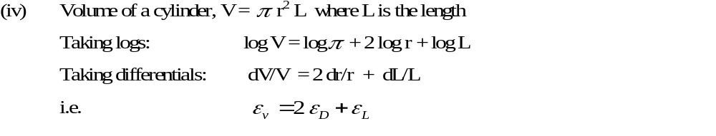
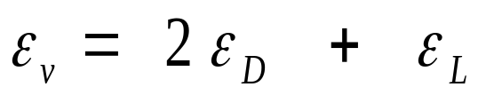
Strains Contd.
Required: Prove the other two statements.

Slide 31
1.5 Elasticity and Hooke’s Law
All solid materials deform when they are stressed, and as stress is increased, deformation also increases.
If a material returns to its original size and shape on removal of load causing deformation, it is said to be elastic.
If the stress is steadily increased, a point is reached when, after the removal of load, not all the induced strain is removed.
This is called the elastic limit.

Slide 32
Hooke’s Law
States that providing the limit of proportionality of a material is not exceeded, the stress is directly proportional to the strain produced.
If a graph of stress and strain is plotted as load is gradually applied, the first portion of the graph will be a straight line.
The slope of this line is the constant of proportionality called modulus of Elasticity, E or Young’s Modulus.
It is a measure of the stiffness of a material.

Slide 33
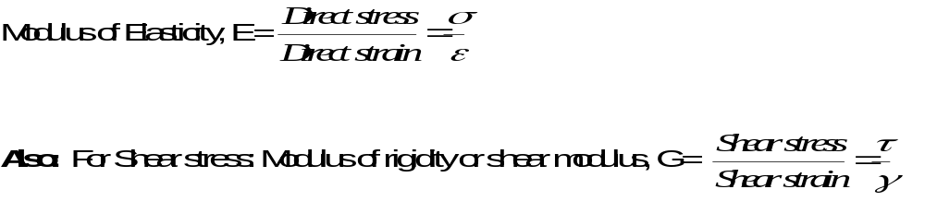



Hooke’s Law
Also: Volumetric strain, is proportional to hydrostatic stress, within the elastic range
i.e. : called bulk modulus.

Slide 34
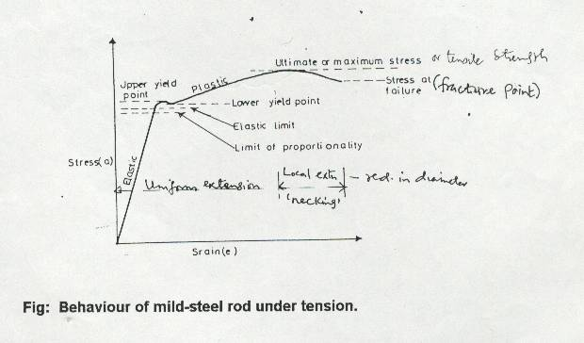
Stress-Strain Relations of Mild Steel

Slide 35
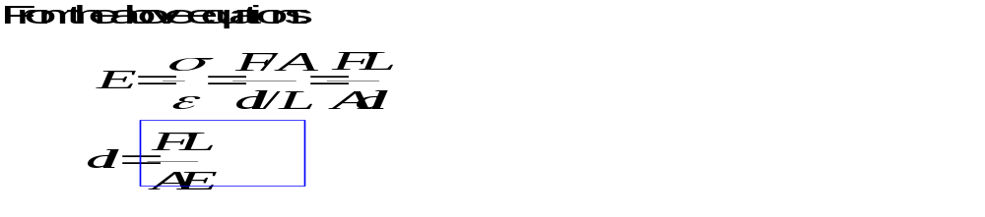
Equation For Extension
This equation for extension is very important

Slide 36
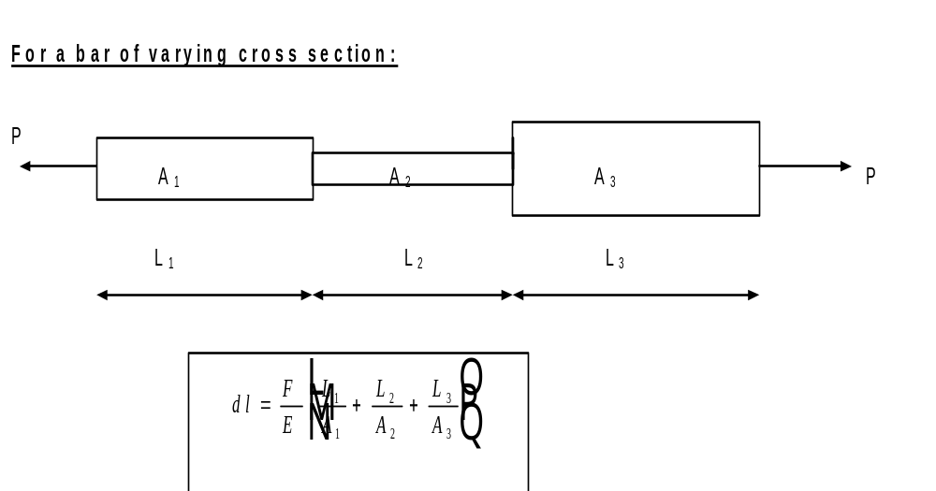
Extension For Bar of Varying Cross Section

Slide 37
Factor of Safety
The load which any member of a machine carries is called working load, and stress produced by this load is the working stress.
Obviously, the working stress must be less than the yield stress, tensile strength or the ultimate stress.
This working stress is also called the permissible stress or the allowable stress or the design stress.

Slide 38
Factor of Safety Contd.
Some reasons for factor of safety include the inexactness or inaccuracies in the estimation of stresses and the non-uniformity of some materials.
Note: Ultimate stress is used for materials e.g. concrete which do not have a well-defined yield point, or brittle materials which behave in a linear manner up to failure. Yield stress is used for other materials e.g. steel with well defined yield stress.

Slide 39
1.7 Practical Class Details
Each Student will have two practical classes: one on :
  Stress/strain characteristics and
  Hardness and impact tests.
(i) The stress/strain characteristics practical will involve the measurement of the characteristics for four metals, copper, aluminium, steel and brass using a tensometer.

Slide 40
Practical Class Details Contd.
The test will be done up to fracture of the metals.
This test will also involve the accurate measurement of the modulus of elasticity for one metal.
There is the incorporation of an extensometer for accurate measurement of very small extensions to produce an accurate stress-strain graphs.
The test will be done up to elastic limit.

Slide 41
Practical Class Details Contd.
(ii) The hardness test will be done using the same four metals and the Rockwell Hardness test.
The impact test with the four metals will be carried out using the Izod test.

Slide 42
1.8 MATERIALS TESTING
1.8.1. Tensile Test: This is the most common test carried out on a material.
It is performed on a machine capable of applying a true axial load to the test specimen. The machine must have:
(i) A means of measuring the applied load and
(ii) An extensometer is attached to the test specimen to determine its extension.

Slide 43
Tensile Test Contd.
Notes: 1. For iron or steel, the limit of proportionality and the elastic limit are virtually same but for other materials like non-ferrous materials, they are different.
2. Up to maximum or ultimate stress, there is no visible reduction in diameter of specimen but after this stress, a local reduction in diameter called necking occurs and this is more well defined as the load falls off up to fracture point.
Original area of specimen is used for analysis.

Slide 44
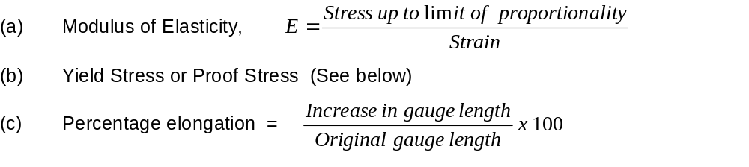
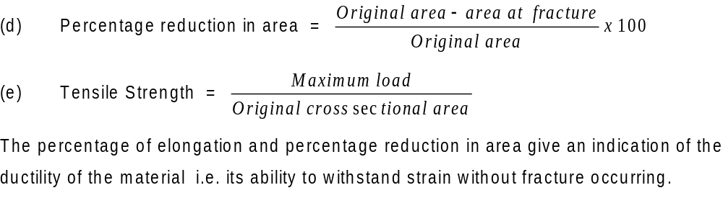
Results From a Tensile Test

Slide 45
Proof Stress
High carbon steels, cast iron and most of the non-ferrous alloys do not exhibit a well defined yield as is the case with mild steel.
For these materials, a limiting stress called proof stress is specified, corresponding to a non-proportional extension.
The non-proportional extension is a specified percentage of the original length e.g. 0.05, 0.10, 0.20 or 0.50%.

Slide 46
Determination of Proof Stress
Stress
Proof Stress
P
Strain
A
The proof stress is obtained by drawing AP parallel to the initial slope of the stress/strain graph, the distance, OA being the strain corresponding to the required non-proportional extension e.g. for 0.05% proof stress, the strain is 0.0005.

Slide 47
1.8.2 Hardness Test
The hardness of a material is determined by its ability to withstand indentation. There are four major hardness tests.
(i) Rockwell Hardness Test: This uses an indentor with a 120º conical diamond with a rounded apex for hard materials, or steel ball for softer materials.
A minor load, F is applied to cause a small indentation as indicated in Fig. (a) below.
The major load, F_{m} is then applied and removed after a specified time to leave load F still acting. The two stages are shown as (b) and (c).

Slide 48
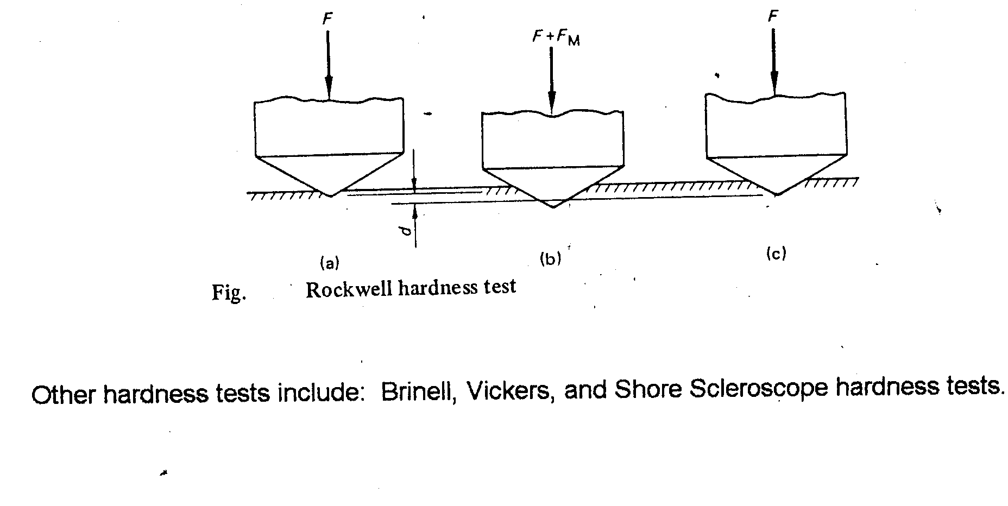
Rockwell Hardness Test

Slide 49
Hardness Test Contd.
Thus the permanent increase in the depth of penetration caused by the major load is d mm. The Rockwell hardness number, H_{R} is:
H_{R} = K - 500 d
Where: K is a constant with value of 100 for the diamond indentor and 130 for the steel indentor.

Slide 50
1.8.3 Impact Testing
The toughness of a material is defined as its ability to withstand a shock loading without fracture. Two principal impact tests are the:
Izod and the
Charpy tests.
A test specimen is rigidly supported and is impacted by a striker attached to a pendulum.

Slide 51
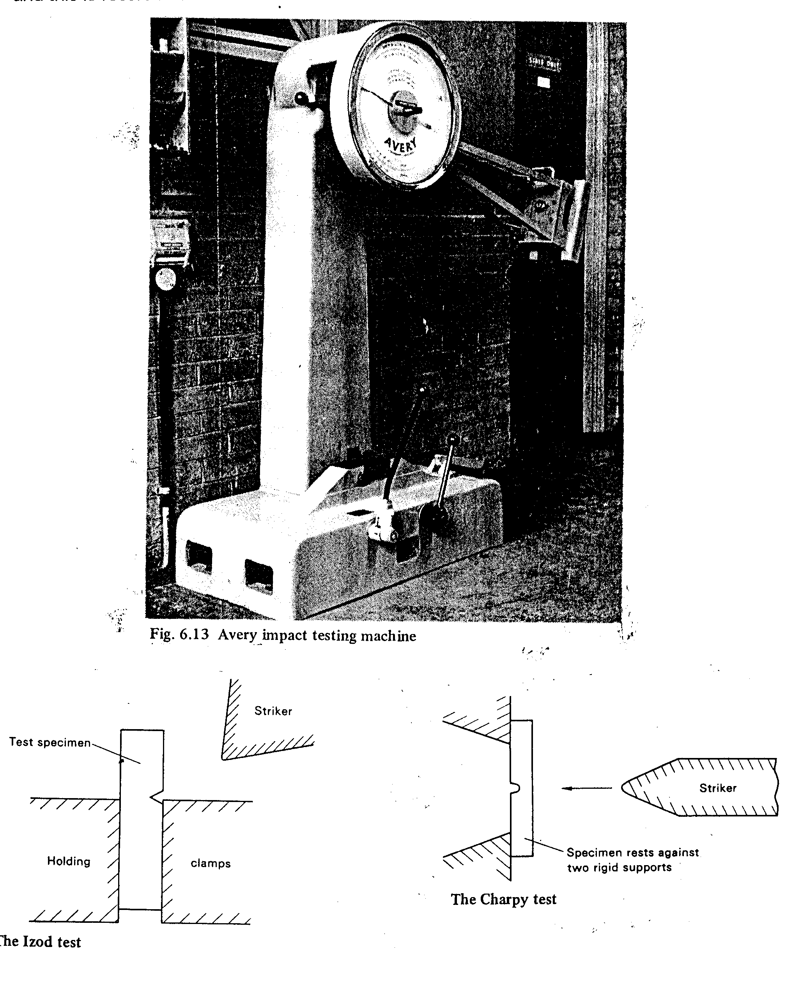

Slide 52
Impact Test Concluded
The difference in height from which a pendulum is released and the height to which it rises after impact gives a measure of the energy absorbed by the specimen and this is recorded on a dial mounted on a tester.

Slide 53
Example on Elongation
A flat plate of steel, 1 cm thick, and of trapezoidal form tapers from 5 cm width to 10 cm width in a length of 40 cm. Determine the elongation under an axial force of 50 kN. E = 2 x 10⁷ N/cm².

Slide 54
Diagram of a Trapezoidal Steel Plate
t
B1
dx
P
P
B2
x
L

Slide 55
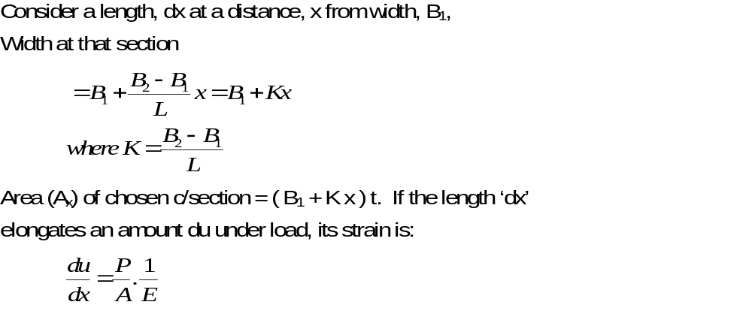
Solution

Slide 56
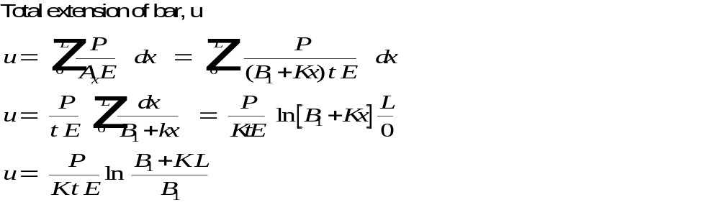
Solution Contd.

Slide 57
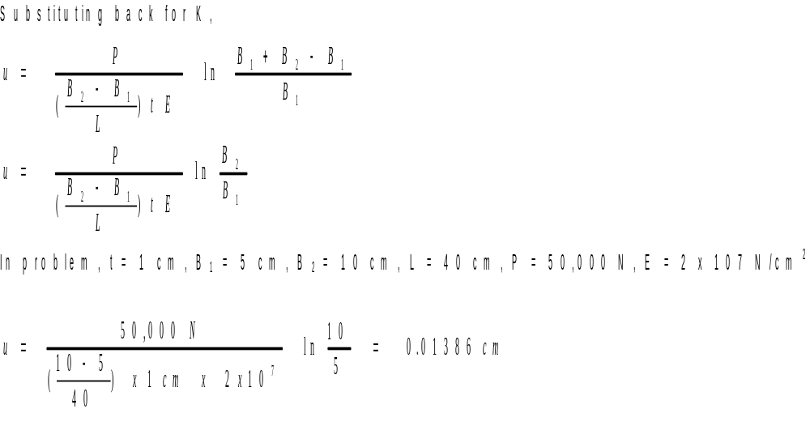
Solution Contd.

Slide 58
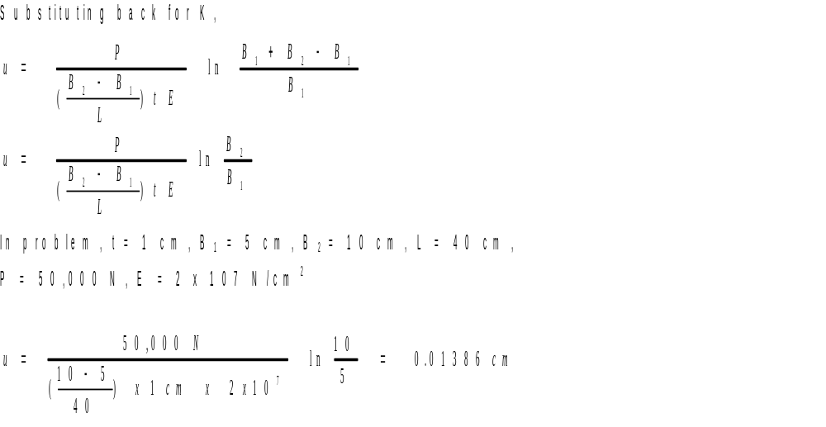
Solution Concluded

Slide 59
1.9 Lateral Strain and Poisson’s Ratio
Under the action of a longitudinal stress, a body will extend in the direction of the stress and contract in the transverse or lateral direction
(see Fig. below).
The reverse occurs under a compressive load.

Slide 60
Stress Effects
P
P
Longitudinal Tensile Stress Effect
P
P
Longitudinal Compressive Stress Effect

Slide 61
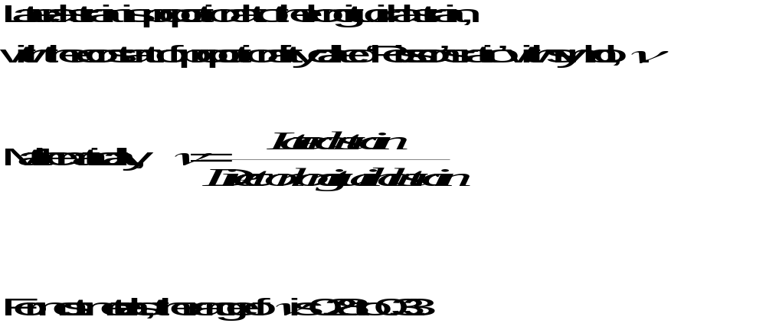
Poisson’s Ratio

Slide 62

1.10 Thermal Strain

Slide 63
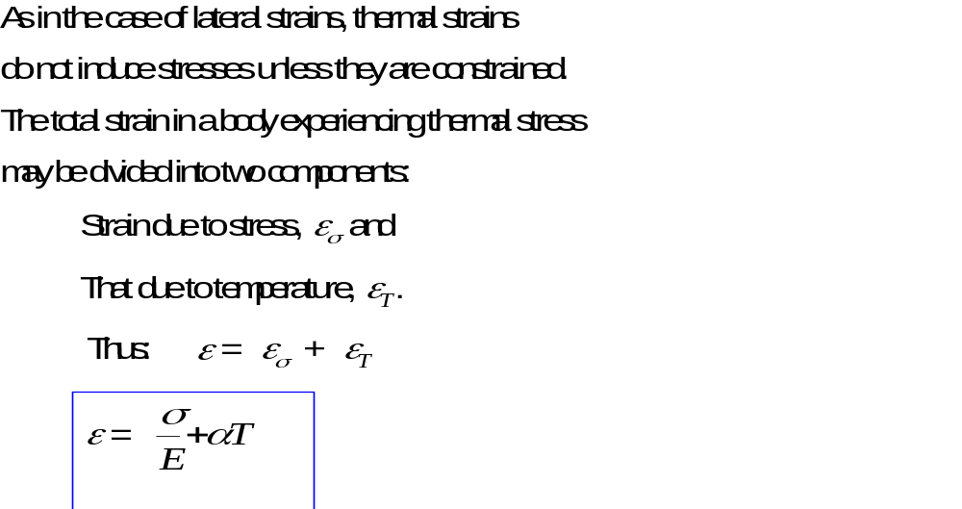
Thermal Strain Contd.

Slide 64
1.11. Principle of Superposition
It states that the effects of several actions taking place simultaneously can be reproduced exactly by adding the effect of each action separately.
The principle is general and has wide applications and holds true if:
(i) The structure is elastic
(ii) The stress-strain relationship is linear
(iii) The deformations are small.

Slide 65
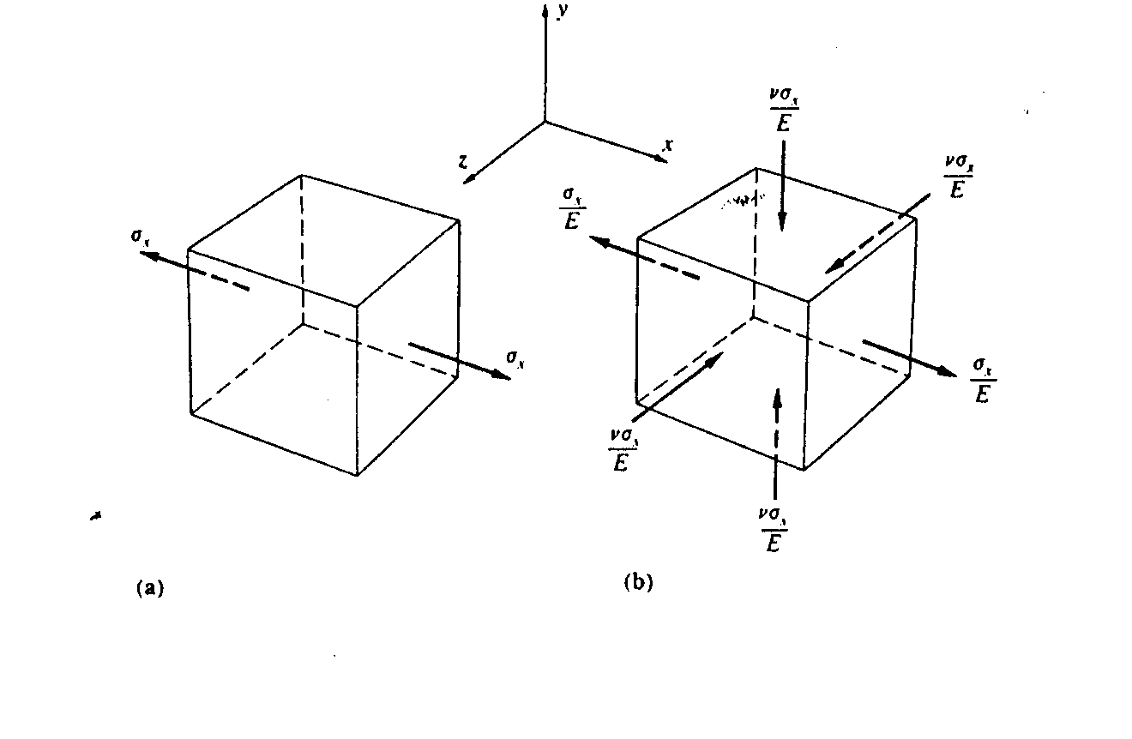
1.12 General Stress-Strain Relationships

Slide 66
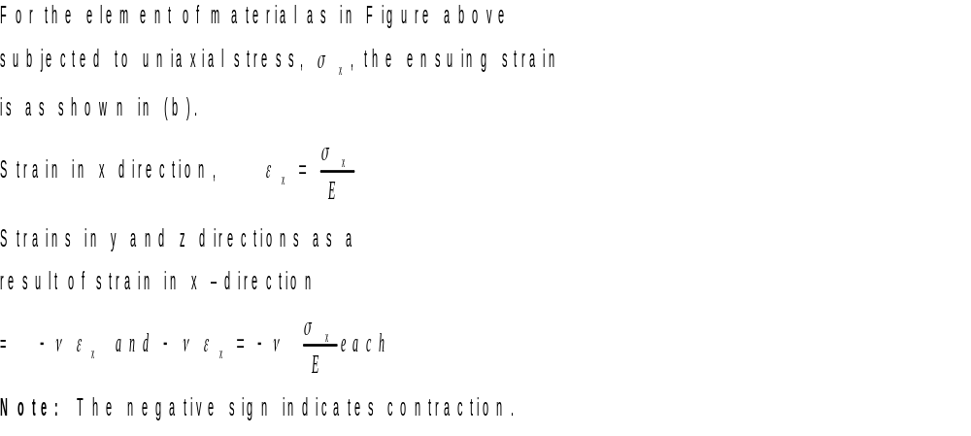
1.12 General Stress-Strain Relationships

Slide 67
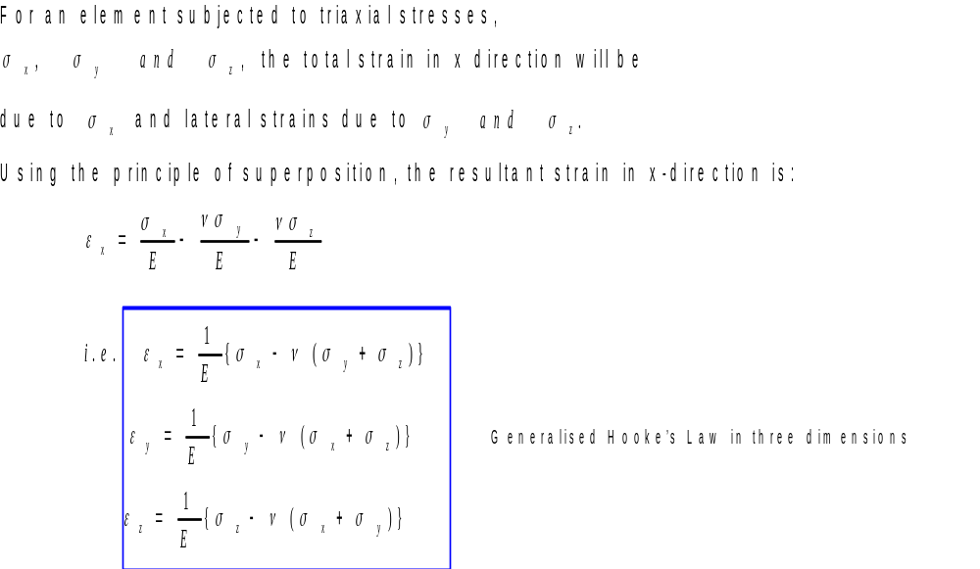
General Stress-Strain Relationships
Contd.

Slide 68
General Stress-Strain Relationships
Contd.
Note: In the case of shear strain, there is no lateral strain, hence the shear stress/shear strain relationship is the same for both uniaxial and complex strain systems.

Slide 69
Plain Stress and Plain Strain
A plain stress condition is said to exist when stress in the z direction is zero.
The above equations may be applied for but strain in the z direction is not zero.
Also plain strain condition exists when the strain in z direction is zero.
Using strain in Z direction as zero in this case does not mean that stress in the z direction is zero.

Slide 70
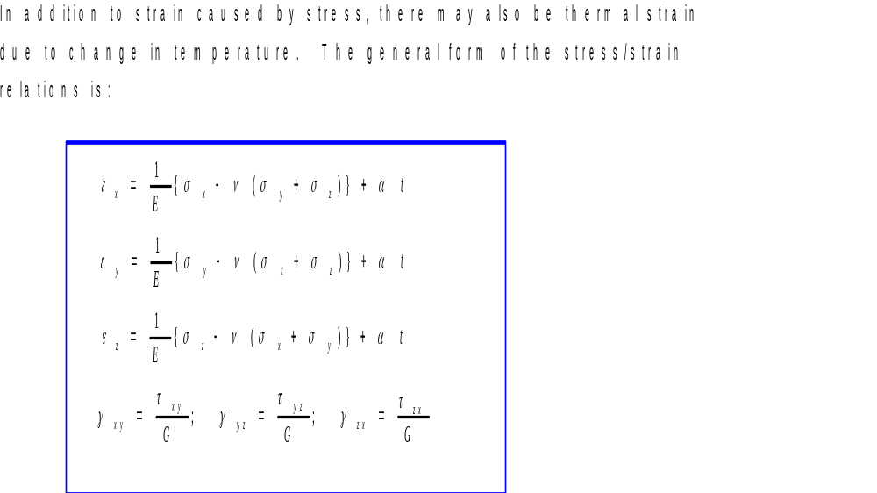
Strain Caused by Stress and Temperature

Slide 71

Try On Your Own

Slide 72
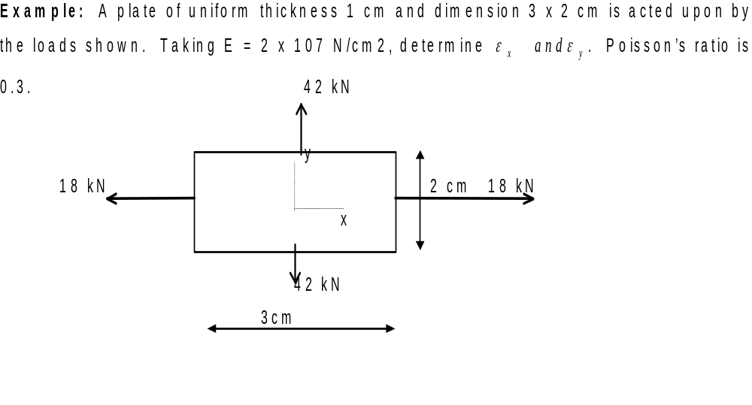
Example

Slide 73
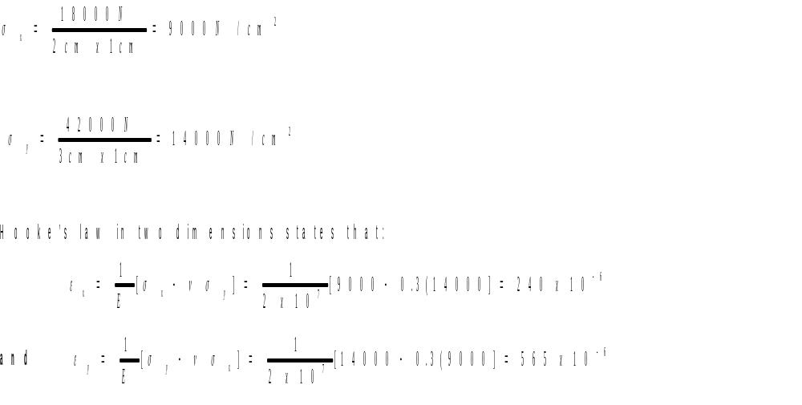
Solution

Slide 74
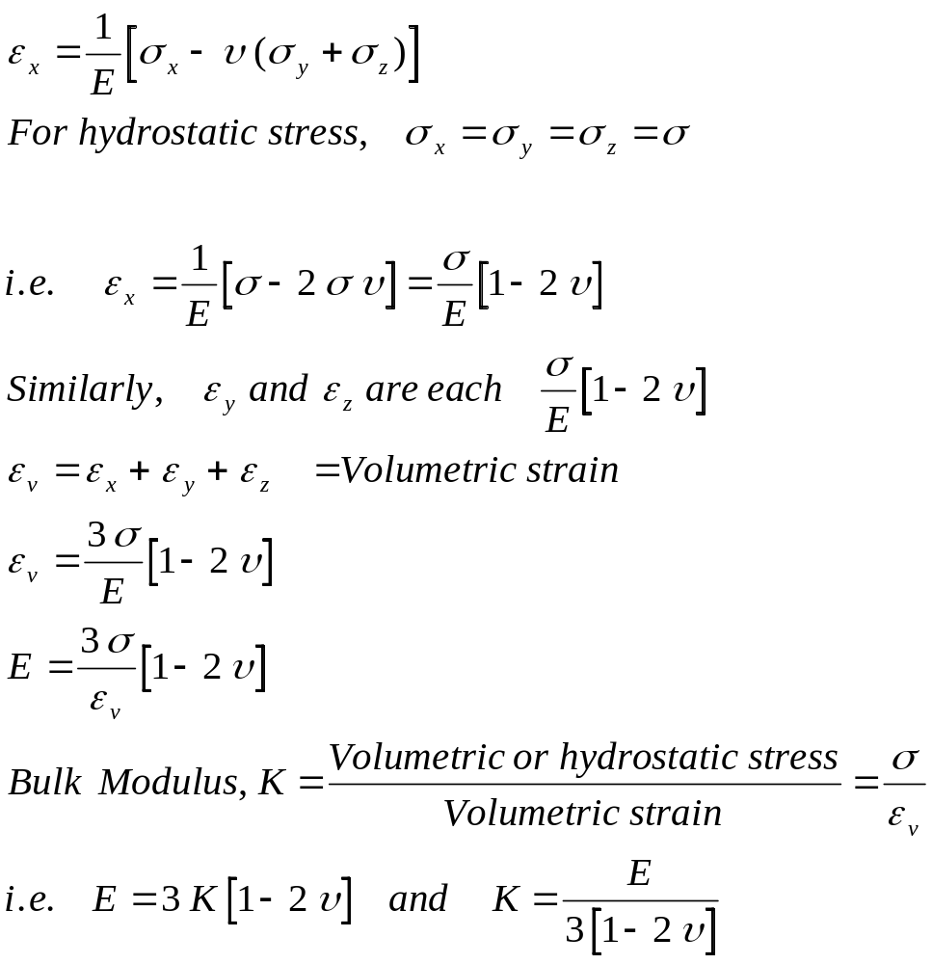
1.13 Relationship between Elastic Modulus (E) and Bulk Modulus, K

Slide 75
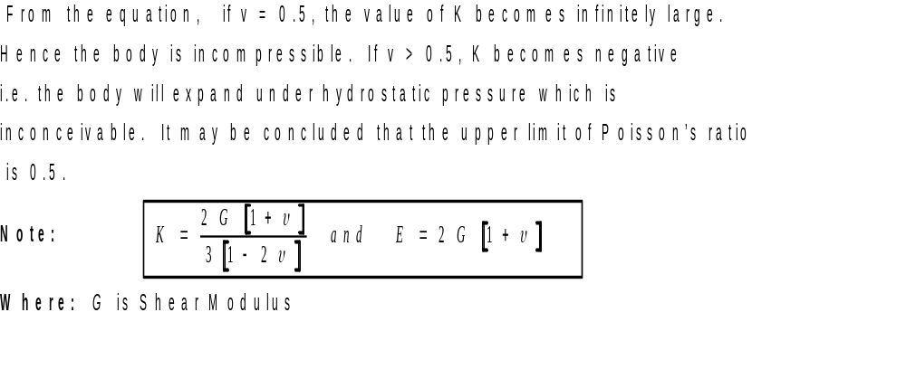
Maximum Value For Poisson’s Ratio

Slide 76
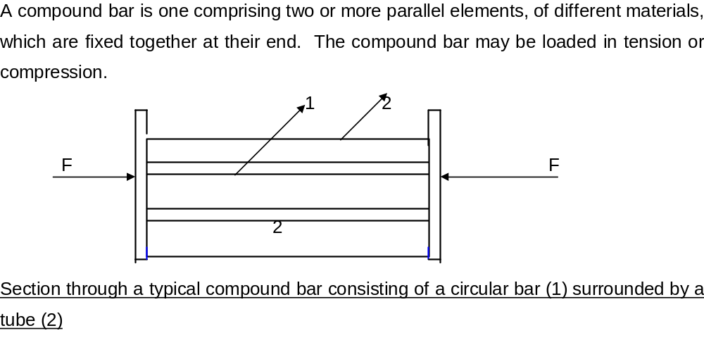
1.14 Compound Bars

Slide 77
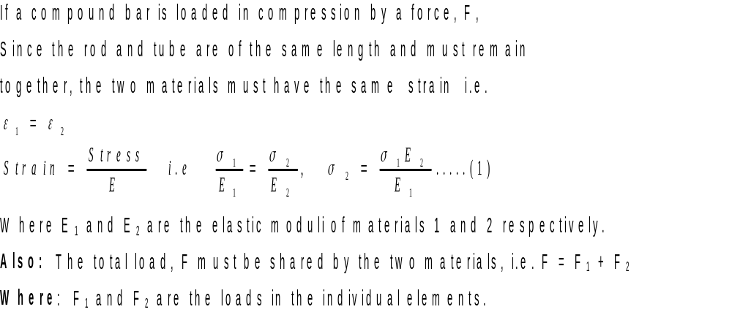
1.14.1 Stresses Due to Applied Loads in Compound Bars

Slide 78
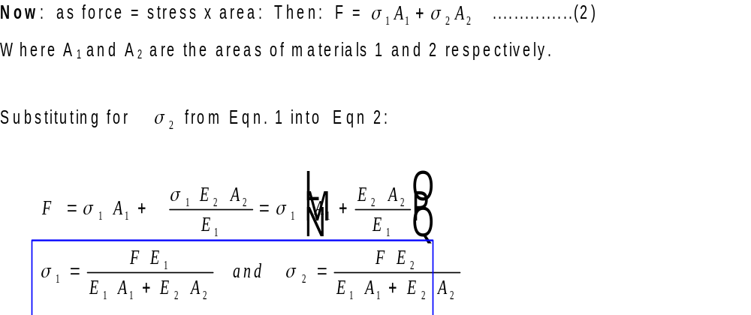
Compound Bars Contd.

Slide 79
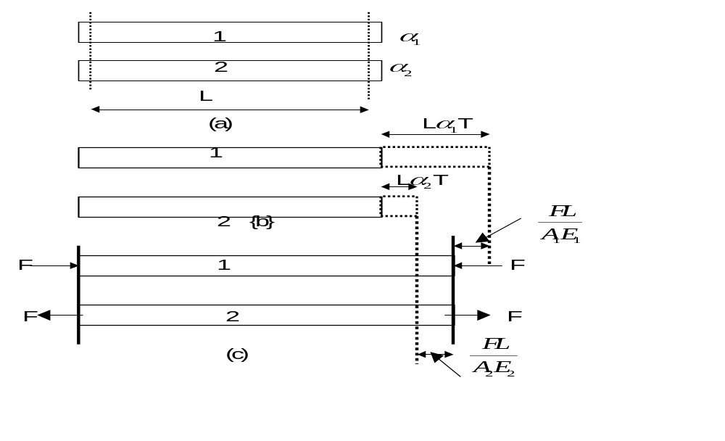
1.14.2 Temperature stresses in compound bars

Slide 80
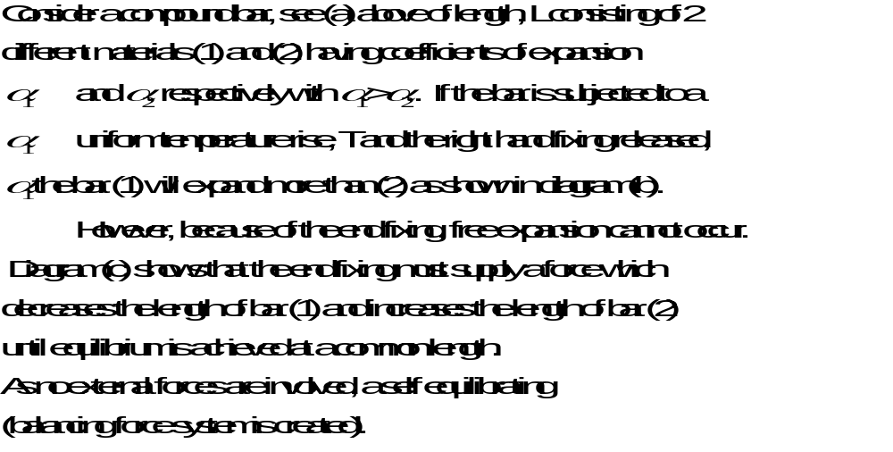
Temperature stresses in compound bar Contd.

Slide 81
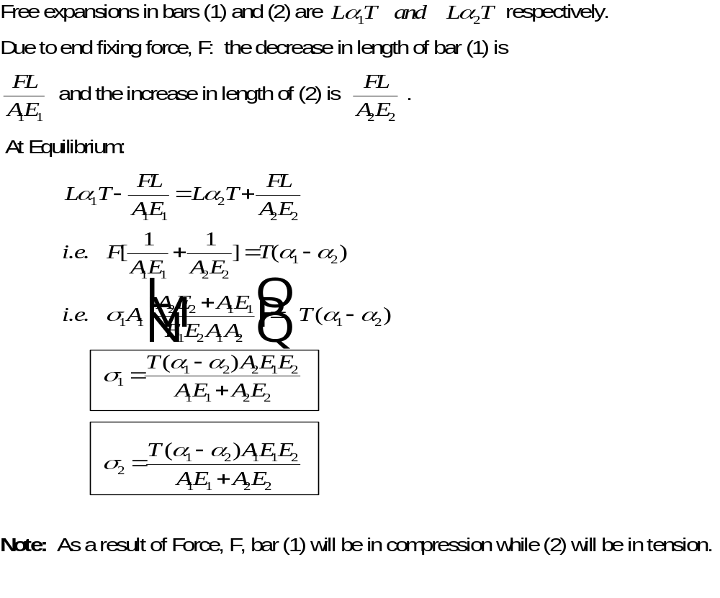
Temperature Stresses Contd.

Slide 82
Example
A steel tube having an external diameter of 36 mm and an internal diameter of 30 mm has a brass rod of 20 mm diameter inside it, the two materials being joined rigidly at their ends when the ambient temperature is 18 ⁰C. Determine the stresses in the two materials: (a) when the temperature is raised to 68 ⁰C (b) when a compressive load of 20 kN is applied at the increased temperature.

Slide 83
Example Contd.
For brass: Modulus of elasticity = 80 GN/m²; Coefficient of expansion = 17 x 10 -6 /⁰C
For steel: Modulus of elasticity = 210 GN/m²; Coefficient of expansion = 11 x 10 -6 /⁰C

Slide 84
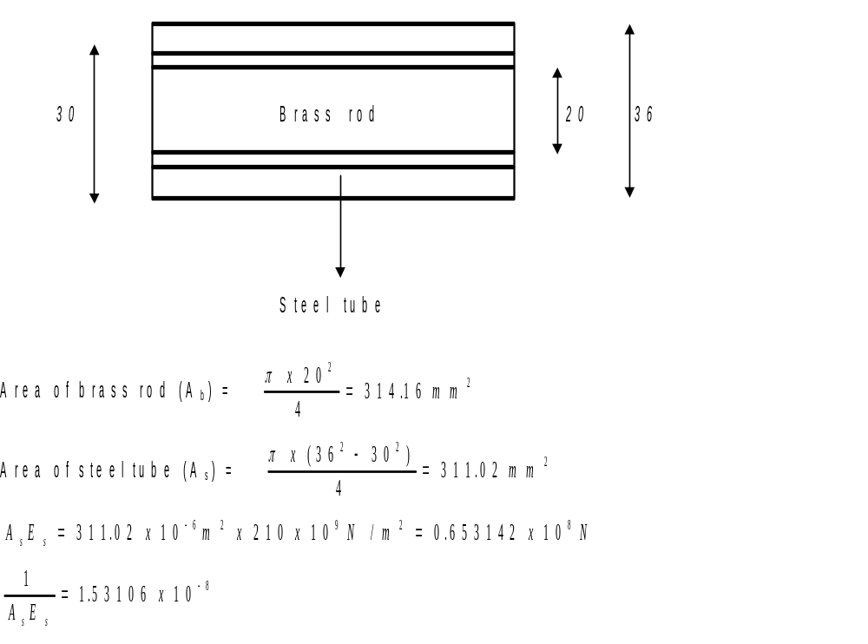
Solution

Slide 85
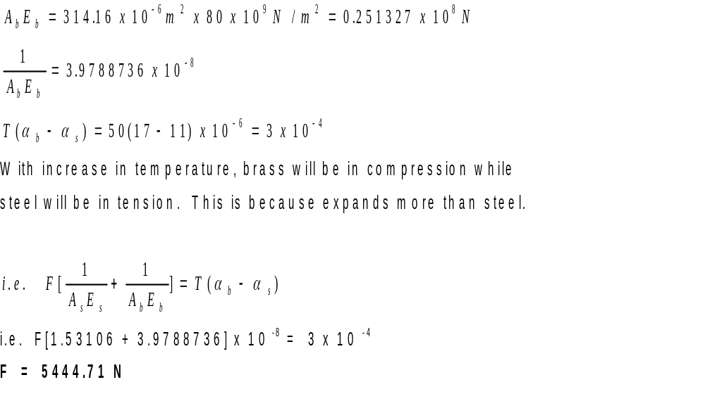
Solution Contd.

Slide 86
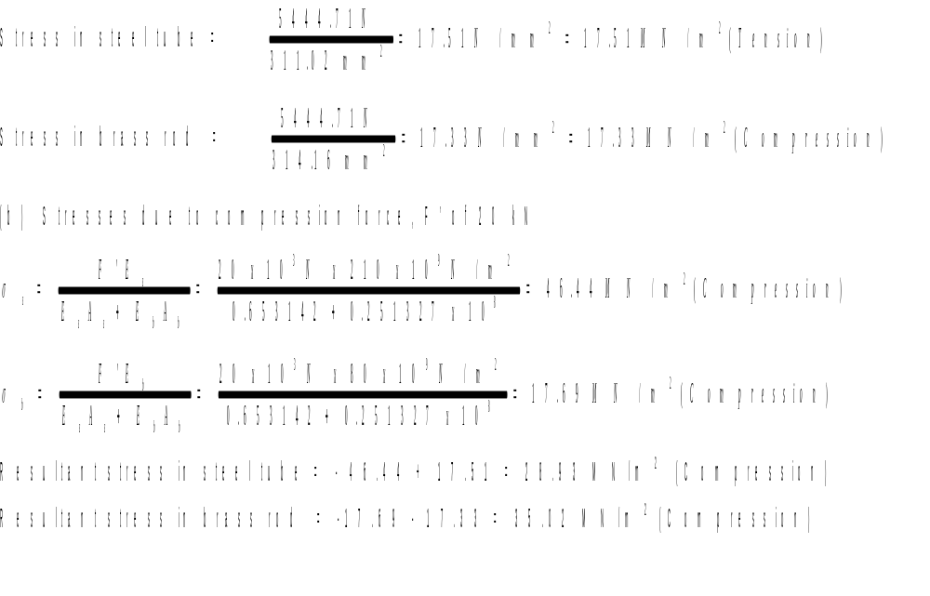
Solution Concluded

Slide 87
Example
A composite bar, 0.6 m long comprises a steel bar 0.2 m long and 40 mm diameter which is fixed at one end to a copper bar having a length of 0.4 m.
Determine the necessary diameter of the copper bar in order that the extension of each material shall be the same when the composite bar is subjected to an axial load.
What will be the stresses in the steel and copper when the bar is subjected to an axial tensile loading of 30 kN? (For steel, E = 210 GN/m²; for copper, E = 110 GN/m²)

Slide 88
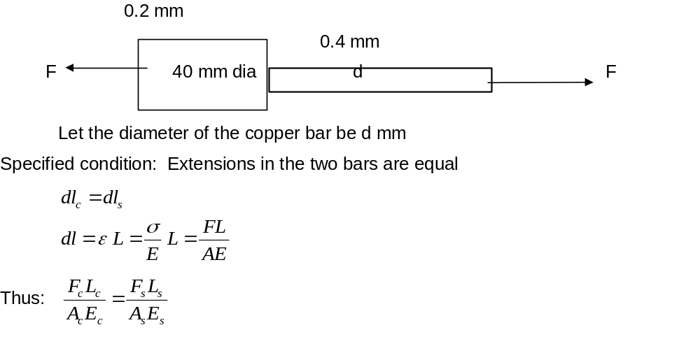
Solution

Slide 89
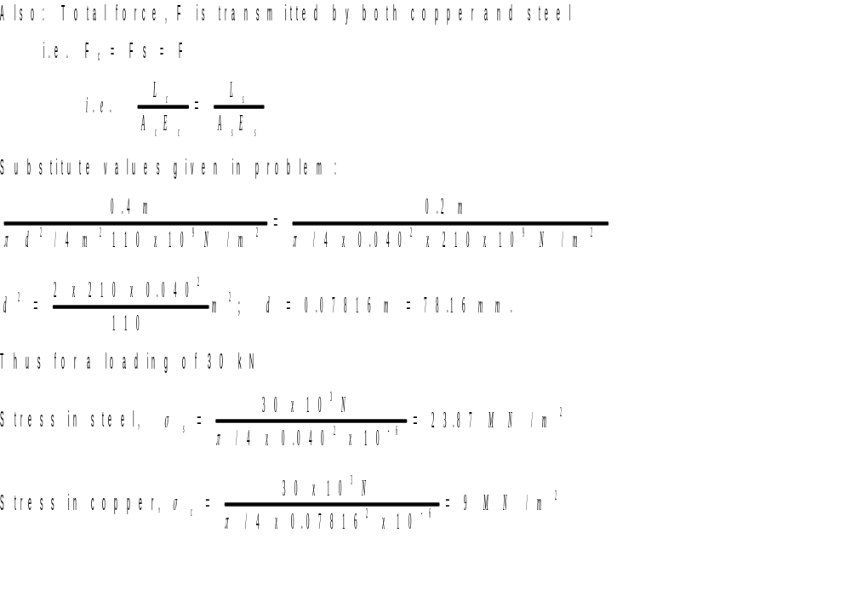
Solution Concluded

Slide 90
1.15 Elastic Strain Energy
If a material is strained by a gradually applied load, then work is done on the material by the applied load.
The work is stored in the material in the form of strain energy.
If the strain is within the elastic range of the material, this energy is not retained by the material upon the removal of load.

Slide 91
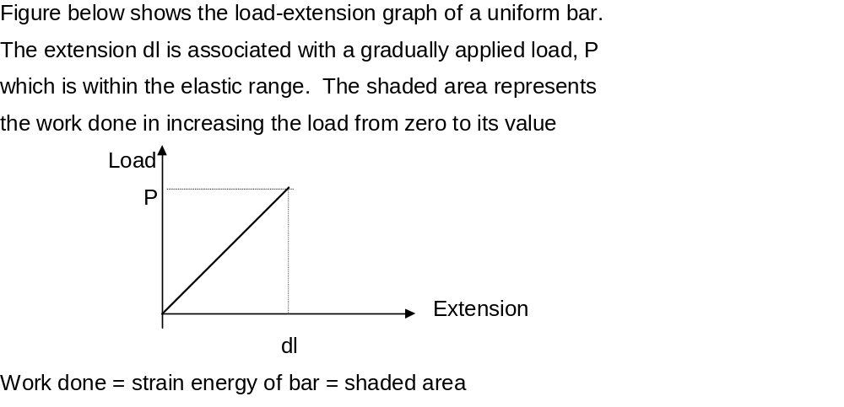
Elastic Strain Energy Contd.

Slide 92
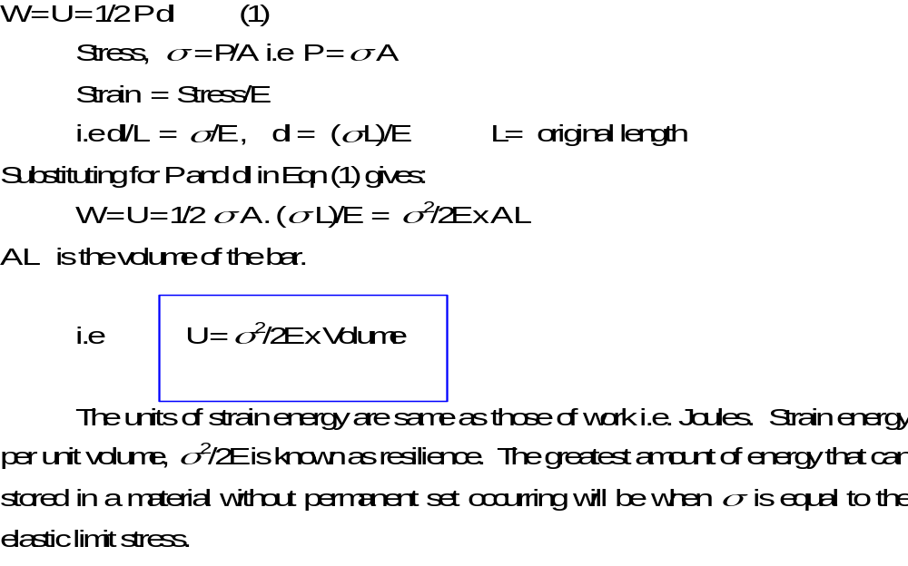
Elastic Strain Energy Concluded

